Slide 1
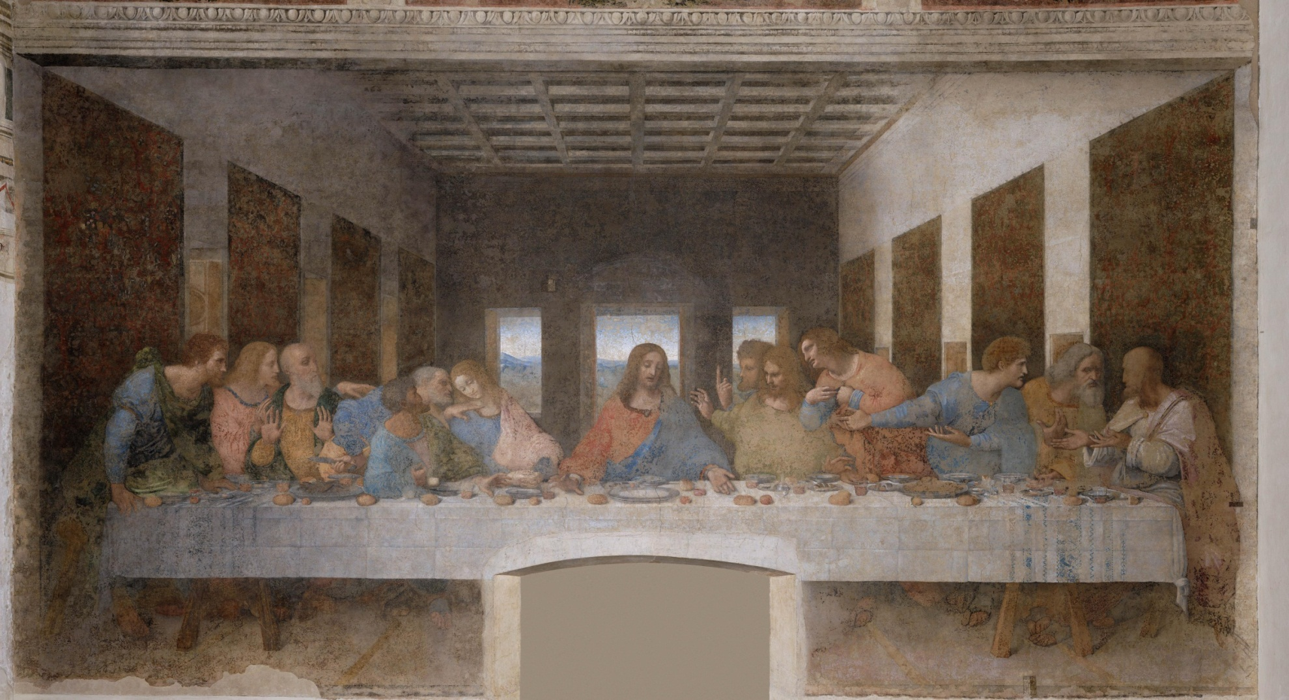
Zodiac Star Template in The Last Supper by Leonardo Da Vinci: A Comparison between Star Shapes and Figure Postures
© Robert Tulip

Slide 2
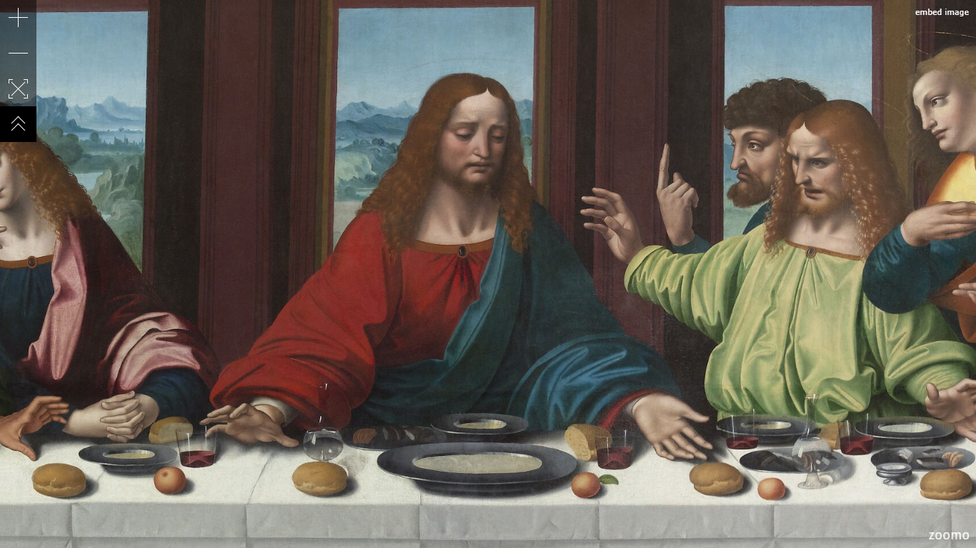
Jesus Christ – Age of Pisces
Image Source: https://www.zoomo.ca/image/l3T

Slide 3
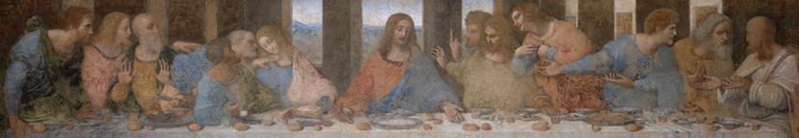
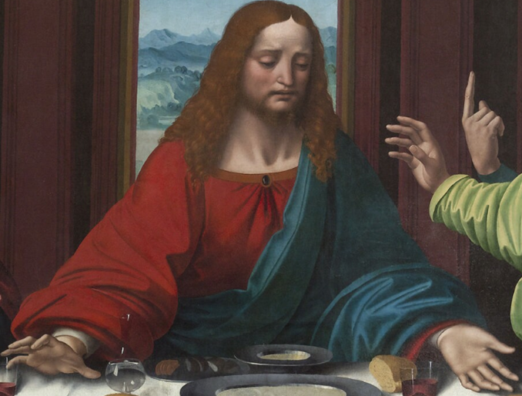

Jesus Christ
Pisces
© Robert Tulip

Slide 4
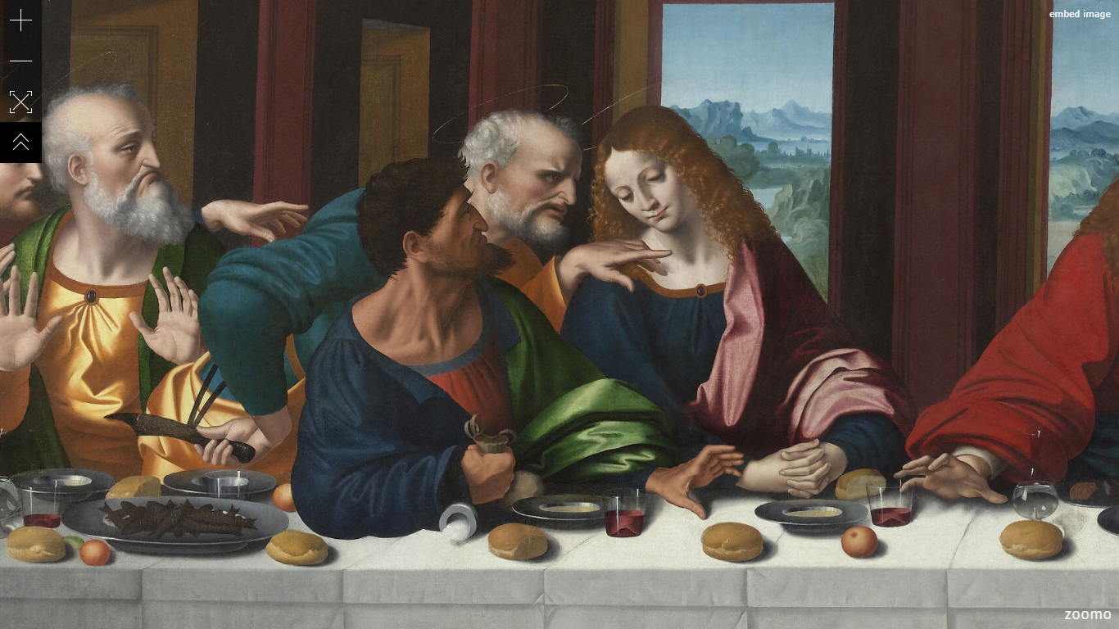
Three Months of Autumn
Image Source: https://www.zoomo.ca/image/l3T

Slide 5

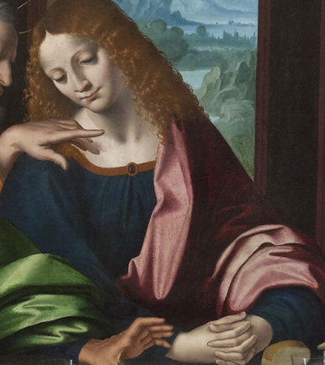
John
Libra
© Robert Tulip

Slide 6
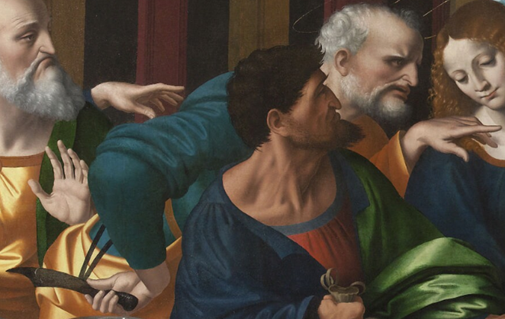

Peter
Scorpio
© Robert Tulip

Slide 7

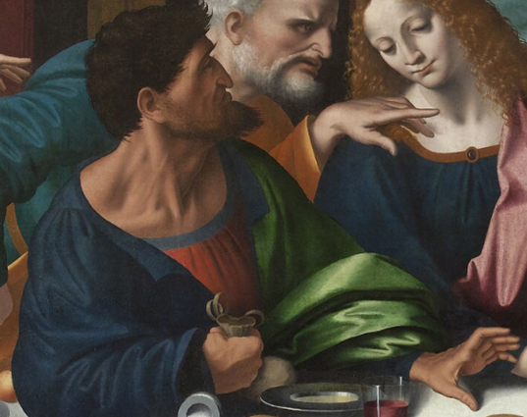
Judas
Sagittarius
© Robert Tulip

Slide 8
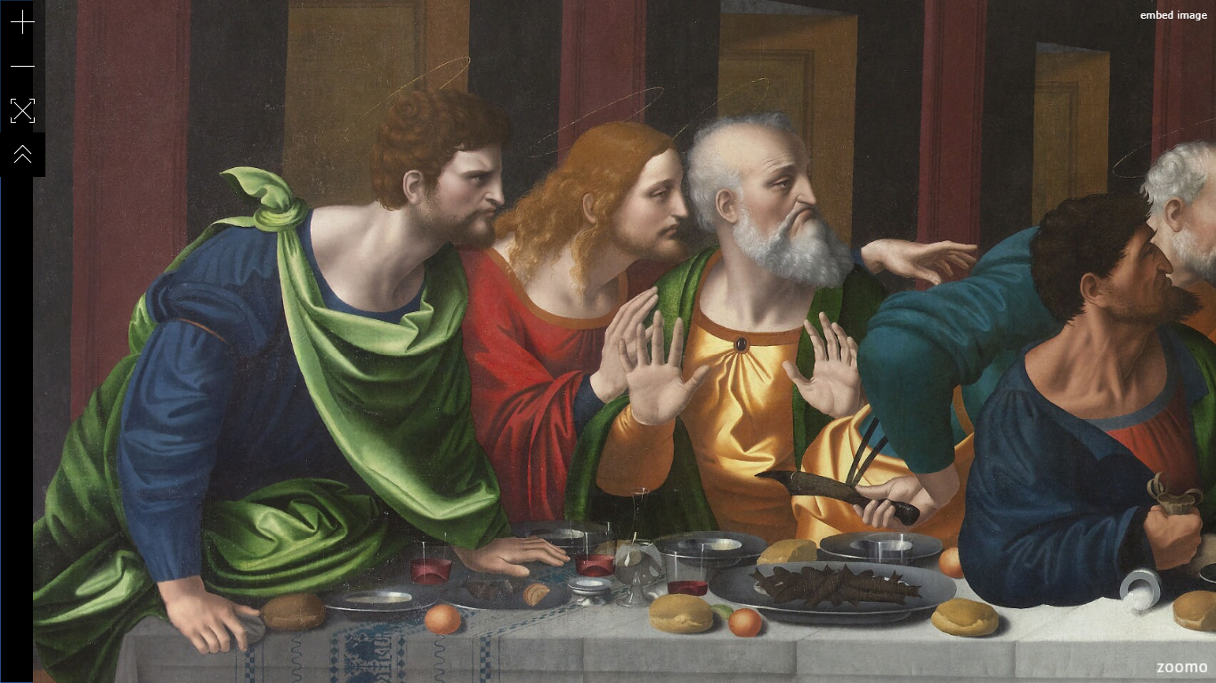
Three Months of Winter
Image Source: https://www.zoomo.ca/image/l3T

Slide 9
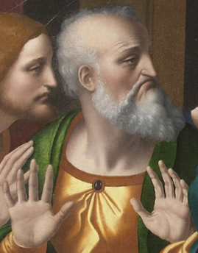

Andrew
Capricorn
© Robert Tulip

Slide 10
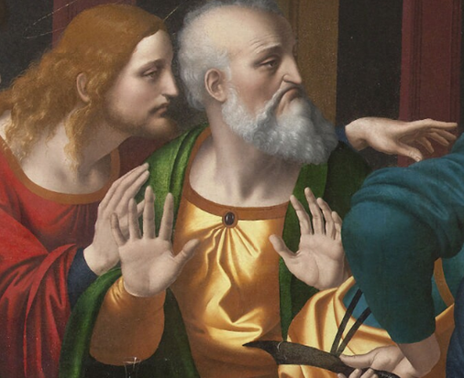

James
Aquarius
© Robert Tulip

Slide 11
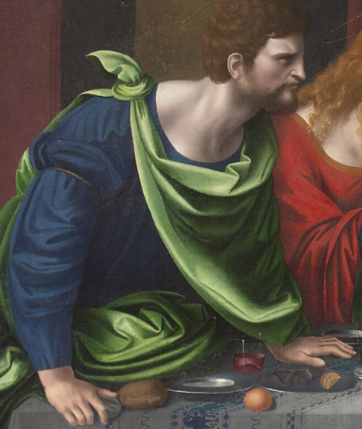
Bartholomew Pisces
© Robert Tulip

