Slide 1
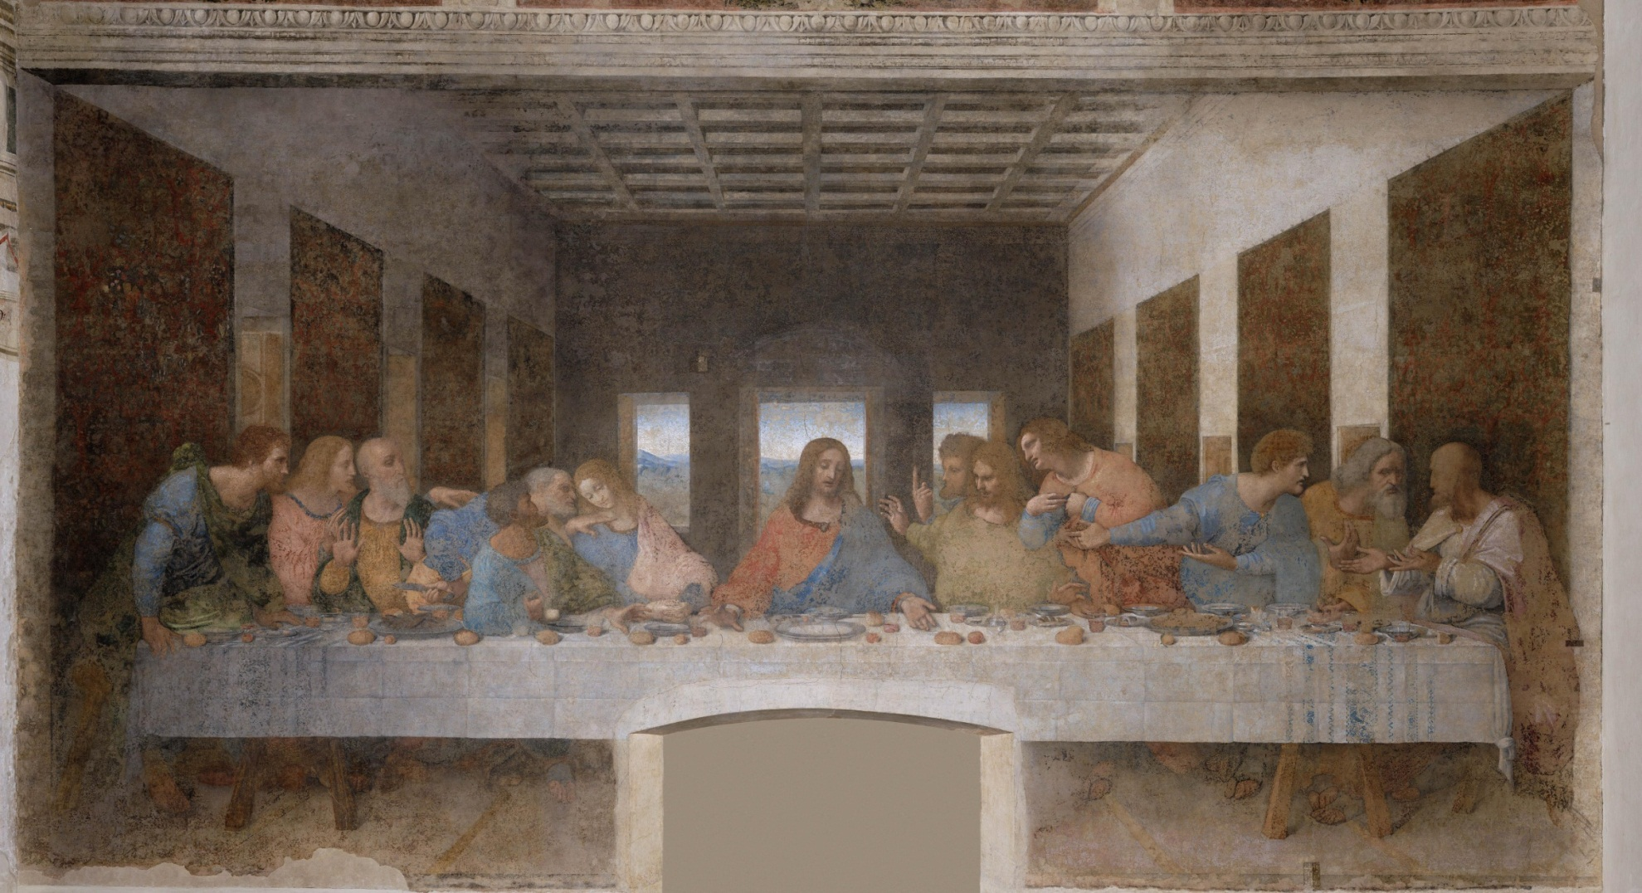
Zodiac Star Template in The Last Supper by Leonardo Da Vinci: A Comparison between Star Shapes and Figure Postures
© Robert Tulip

Slide 2
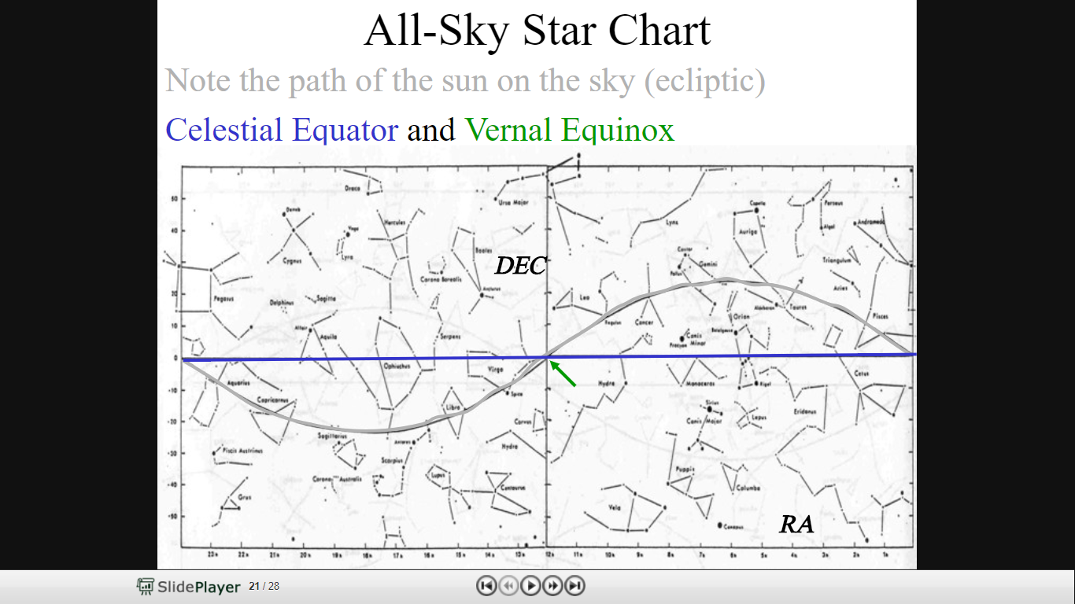

Zodiac Constellations Last Supper Overview
Gemini
Aries
Leo
Taurus
Pisces
Cancer
Celestial Equator
Virgo
Aquarius
Capricorn
Libra
Zodiac
Sagittarius
Scorpio
Star Map Source: http://slideplayer.com/slide/5128341/

Slide 3
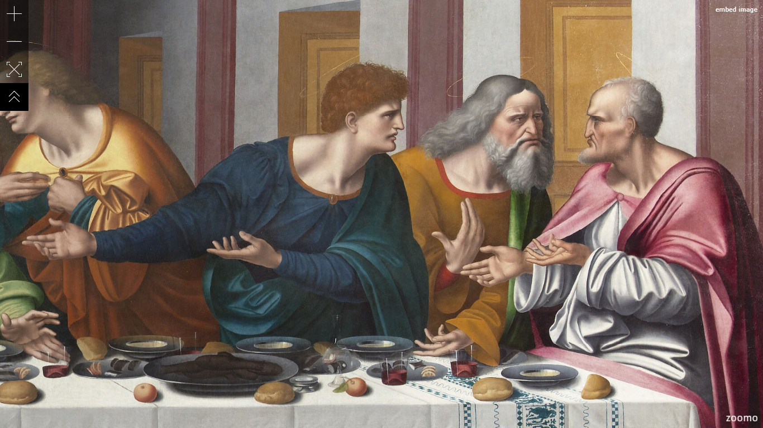
Three Months of Spring
Image Source: https://www.zoomo.ca/image/l3T

Slide 4
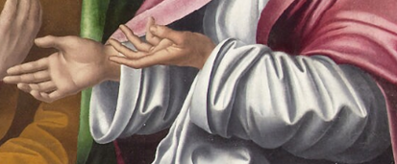
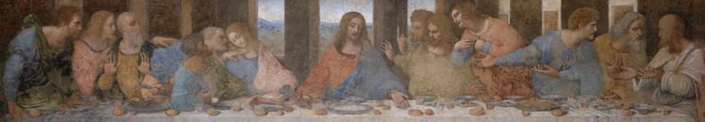
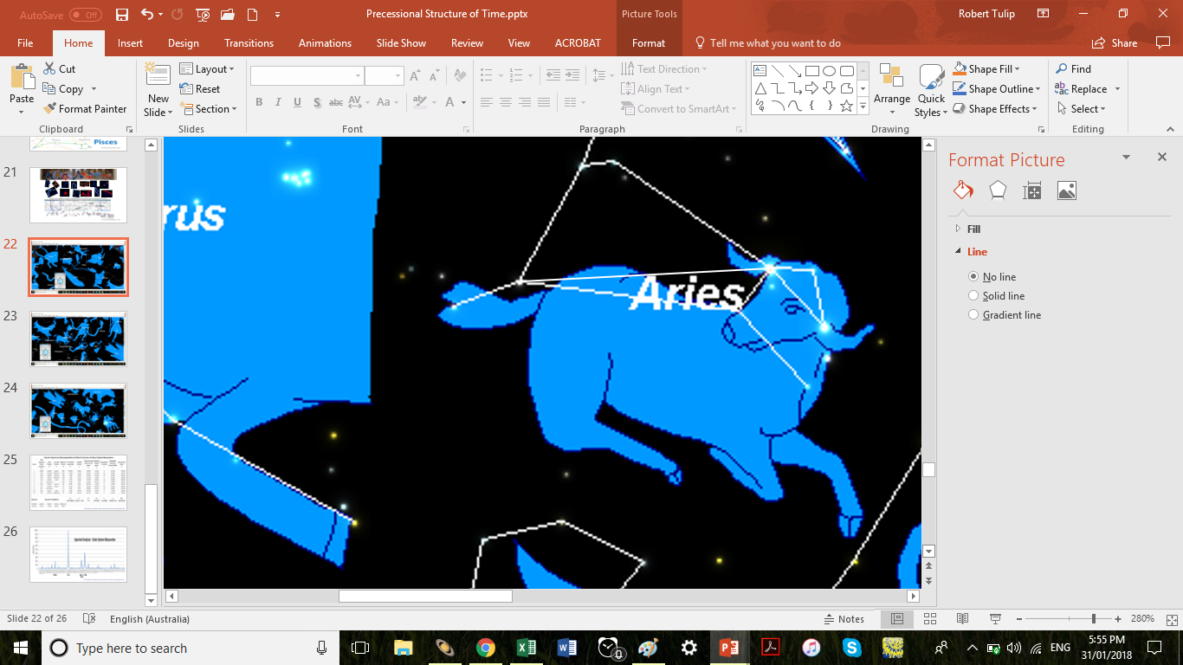
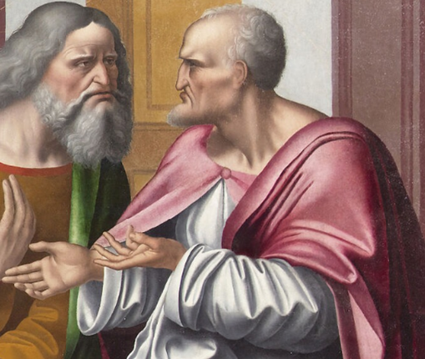
Simon
Aries
© Robert Tulip

Slide 5
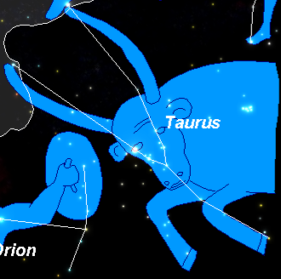
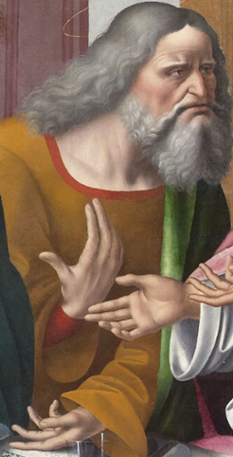
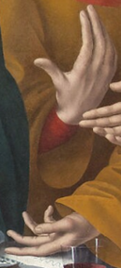
Hyades
Thaddeus
Taurus
Pleiades
© Robert Tulip

Slide 6
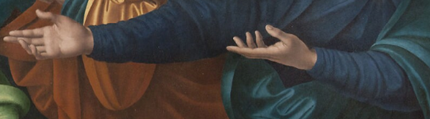

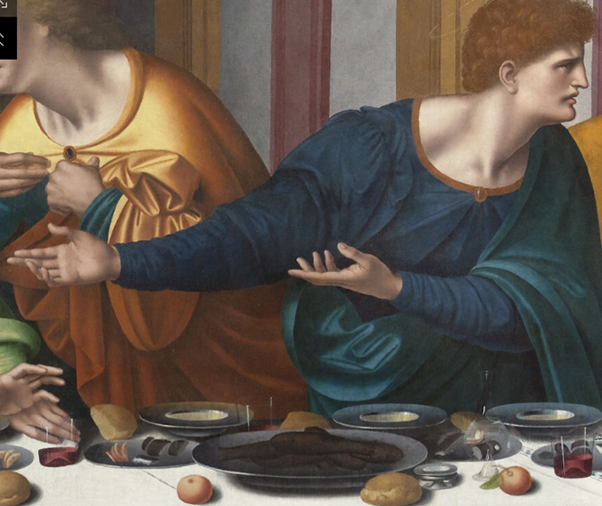
Matthew
Gemini
© Robert Tulip

Slide 7
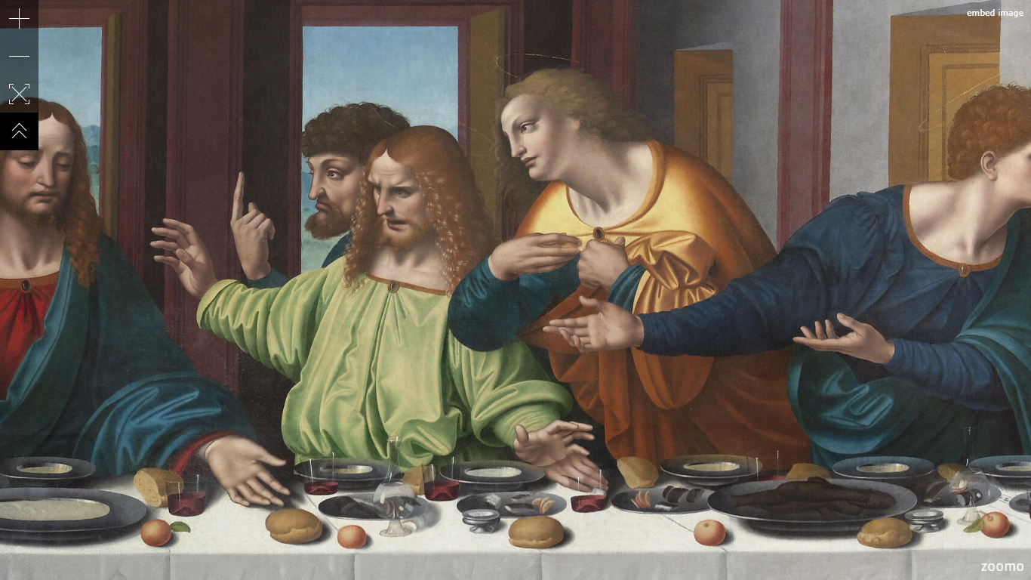
Three Months of Summer
Image Source: https://www.zoomo.ca/image/l3T

Slide 8
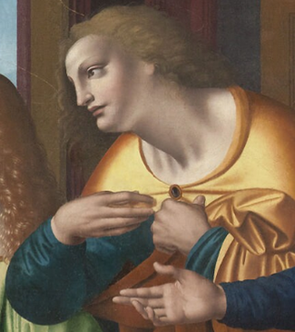

Philip
Cancer
© Robert Tulip

Slide 9
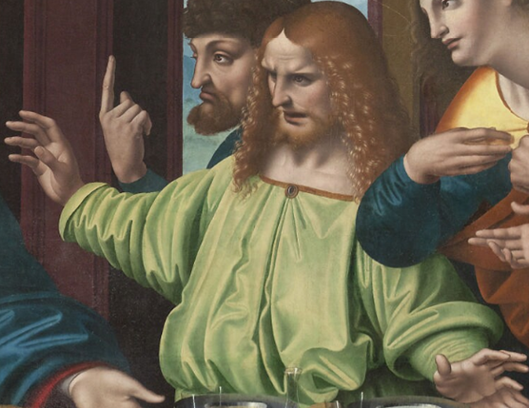
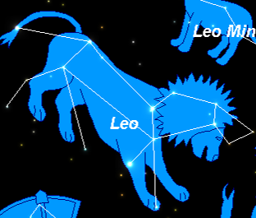
James
Leo
© Robert Tulip

Slide 10


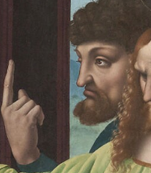
Thomas
Virgo
© Robert Tulip

Slide 11
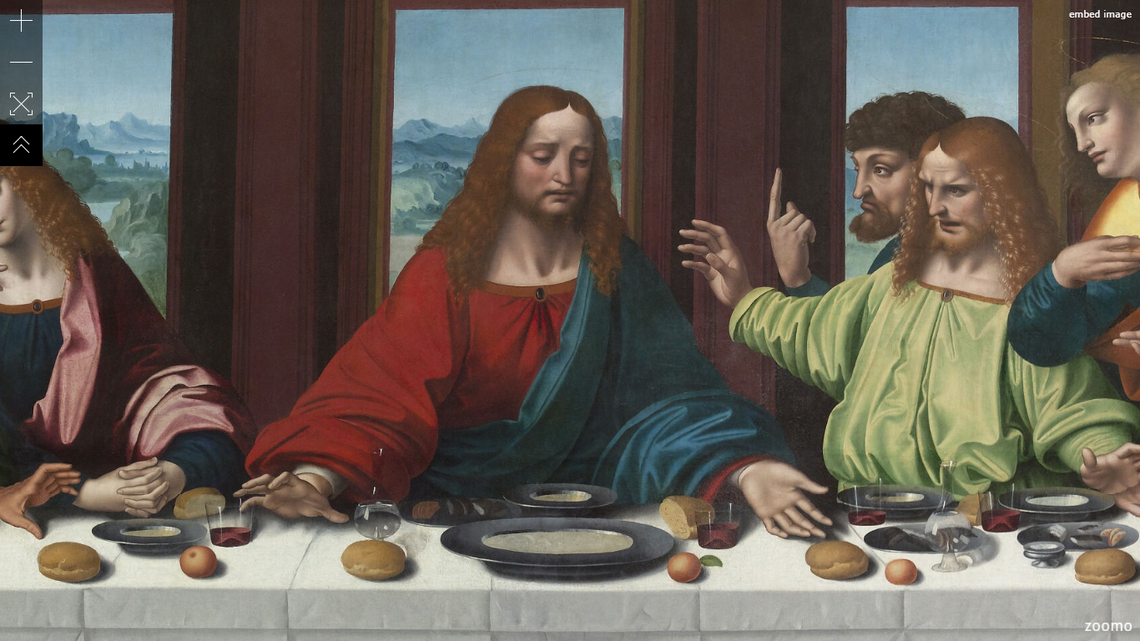
Jesus Christ – Age of Pisces
Image Source: https://www.zoomo.ca/image/l3T

