Slide 1
Restorative Ocean Geoengineering
to Prevent
Global Warming

Slide 2
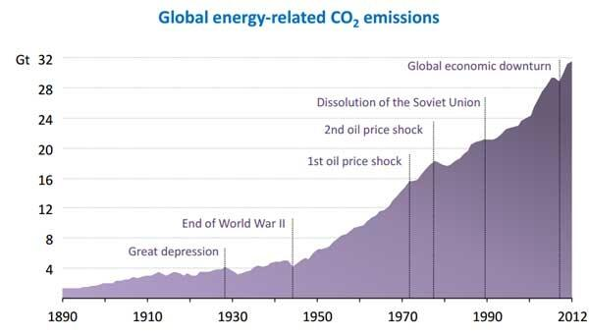
???
Restorative Ocean Geoengineering
to Prevent
Global Warming
Kyoto Target?
Source: Climate Progress
Incentives?
Interests?
Institutions?
(Teskey)

Slide 3
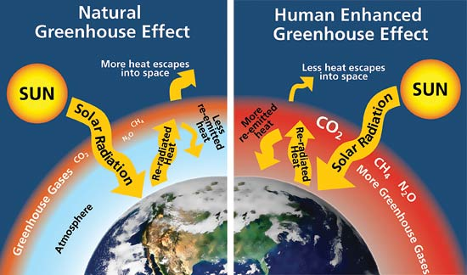
(Holocene)
(Anthropocene)
Solar Radiation Management
Carbon Dioxide Removal
http://www.nps.gov/goga/naturescience/climate-change-causes.htm

Slide 4
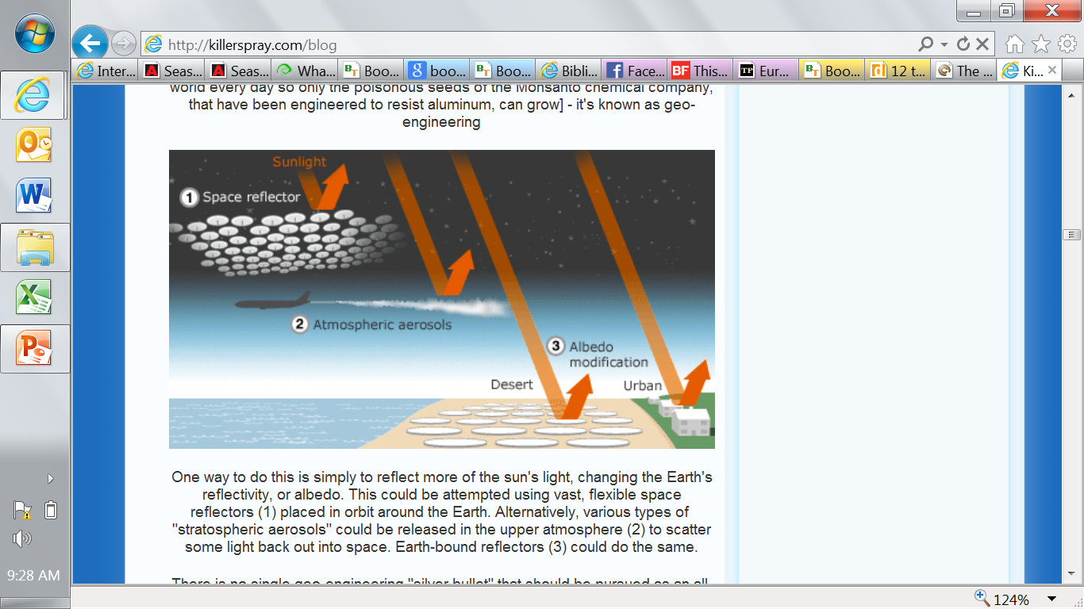
Solar Radiation Management may prevent some of the worst effects of global warming
But SRM does not slow growth of CO2 level or ocean acidification
Emergency Tourniquet?

Slide 5
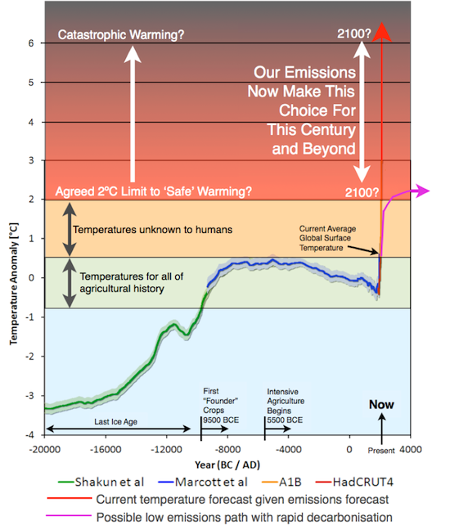
Anthropocene
Holocene
Ice Age
Source: Climate Progress: Unfortunately, The World Is Still Barreling Towards Climate Cataclysm

Slide 6
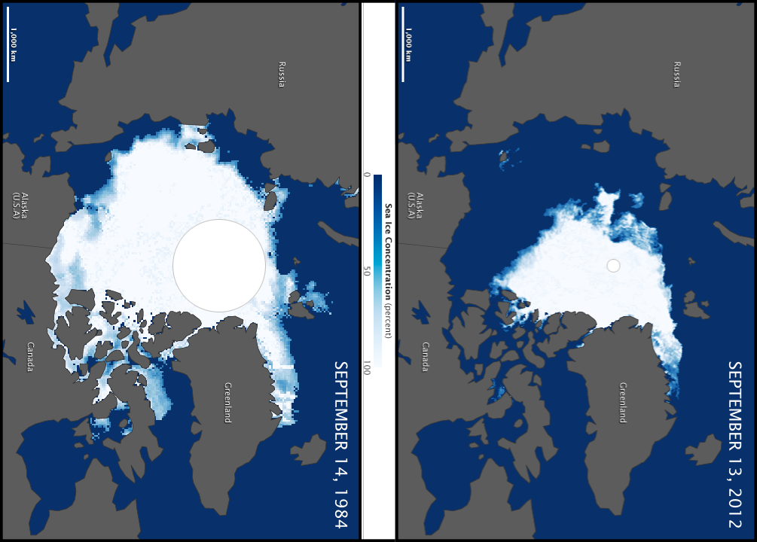
Collapse of Arctic Sea Ice Minimum
1984
2012
Bad Albedo Feedback Loop
http://en.wikipedia.org/wiki/Climate_change_in_the_Arctic

Slide 7


Death
Famine
War
Plague
Climate Change

Slide 8
Center for Global Development Takeaways from IPCC 5
https://www.devex.com/en/news/12-takeaways-from-the-ipcc-report/81997
1. Climate change is undeniably occurring.
2. We’ve never seen anything like this before.
3. Humans are the cause.
4. Climate change will continue.
5. Get ready for more heat waves…
6. …more and bigger storms…
7. …less ice and snow…
8. …higher sea levels…
9. …and acid oceans.
10. These changes will be with us for a long time.
11. How bad things get is up to us.
12. It’s irreversible* (but there’s an asterisk).
*?

Slide 9
Inter-Governmental Panel on Climate Change
5TH ASSESSMENT REPORT, 2013
“A large fraction of anthropogenic climate change resulting from CO2 emissions is irreversible on a multi-century to millennial time scale,*
except in the case of a large net removal of CO2 from the atmosphere over a sustained period.”

Slide 10

* With Technological Fix through Restorative Ocean Geoengineering
*

Slide 11
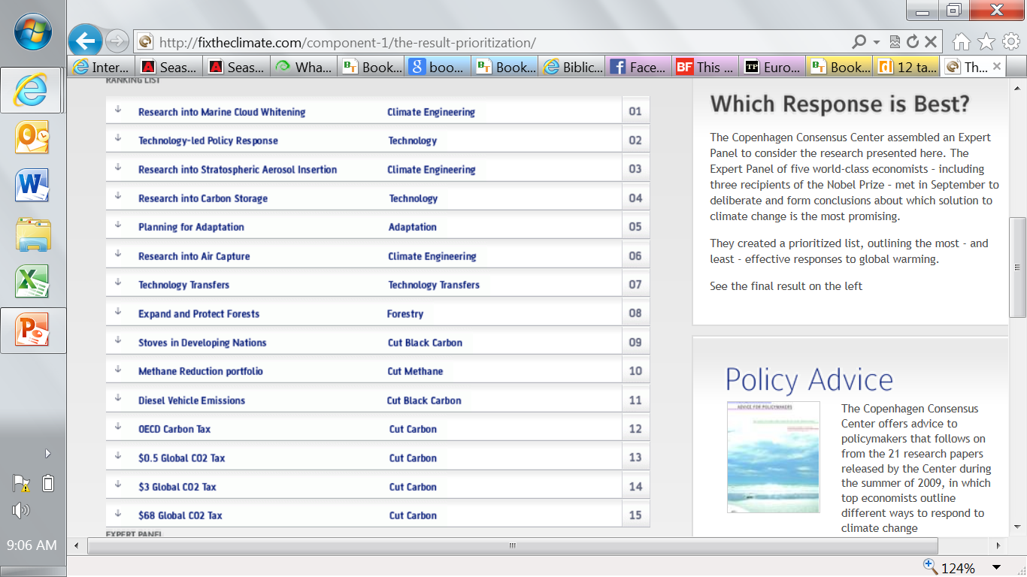
http://fixtheclimate.com/

Slide 12
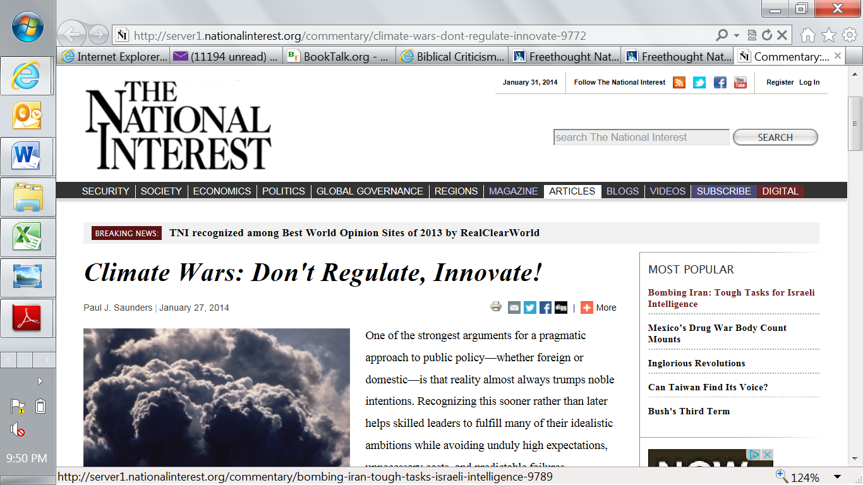

Slide 13
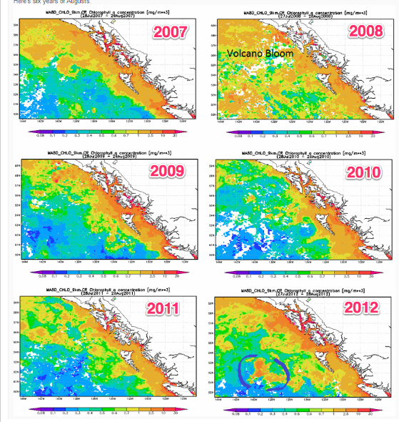
Ocean Restoration through Iron Fertilization?
Amount of algae in Pacific Ocean near Canada
Dumping?
Apparent result of Haida Salmon Iron Experiment
http://russgeorge.net/wp-content/uploads/2013/03/bloom_sixyears_marked1.png

Slide 14

Solar Radiation Management - a shill for big oil?
Geoengineering as scheme to avoid need for emission reduction?
Do you sincerely want to be poor, fighting and hot?

Slide 15
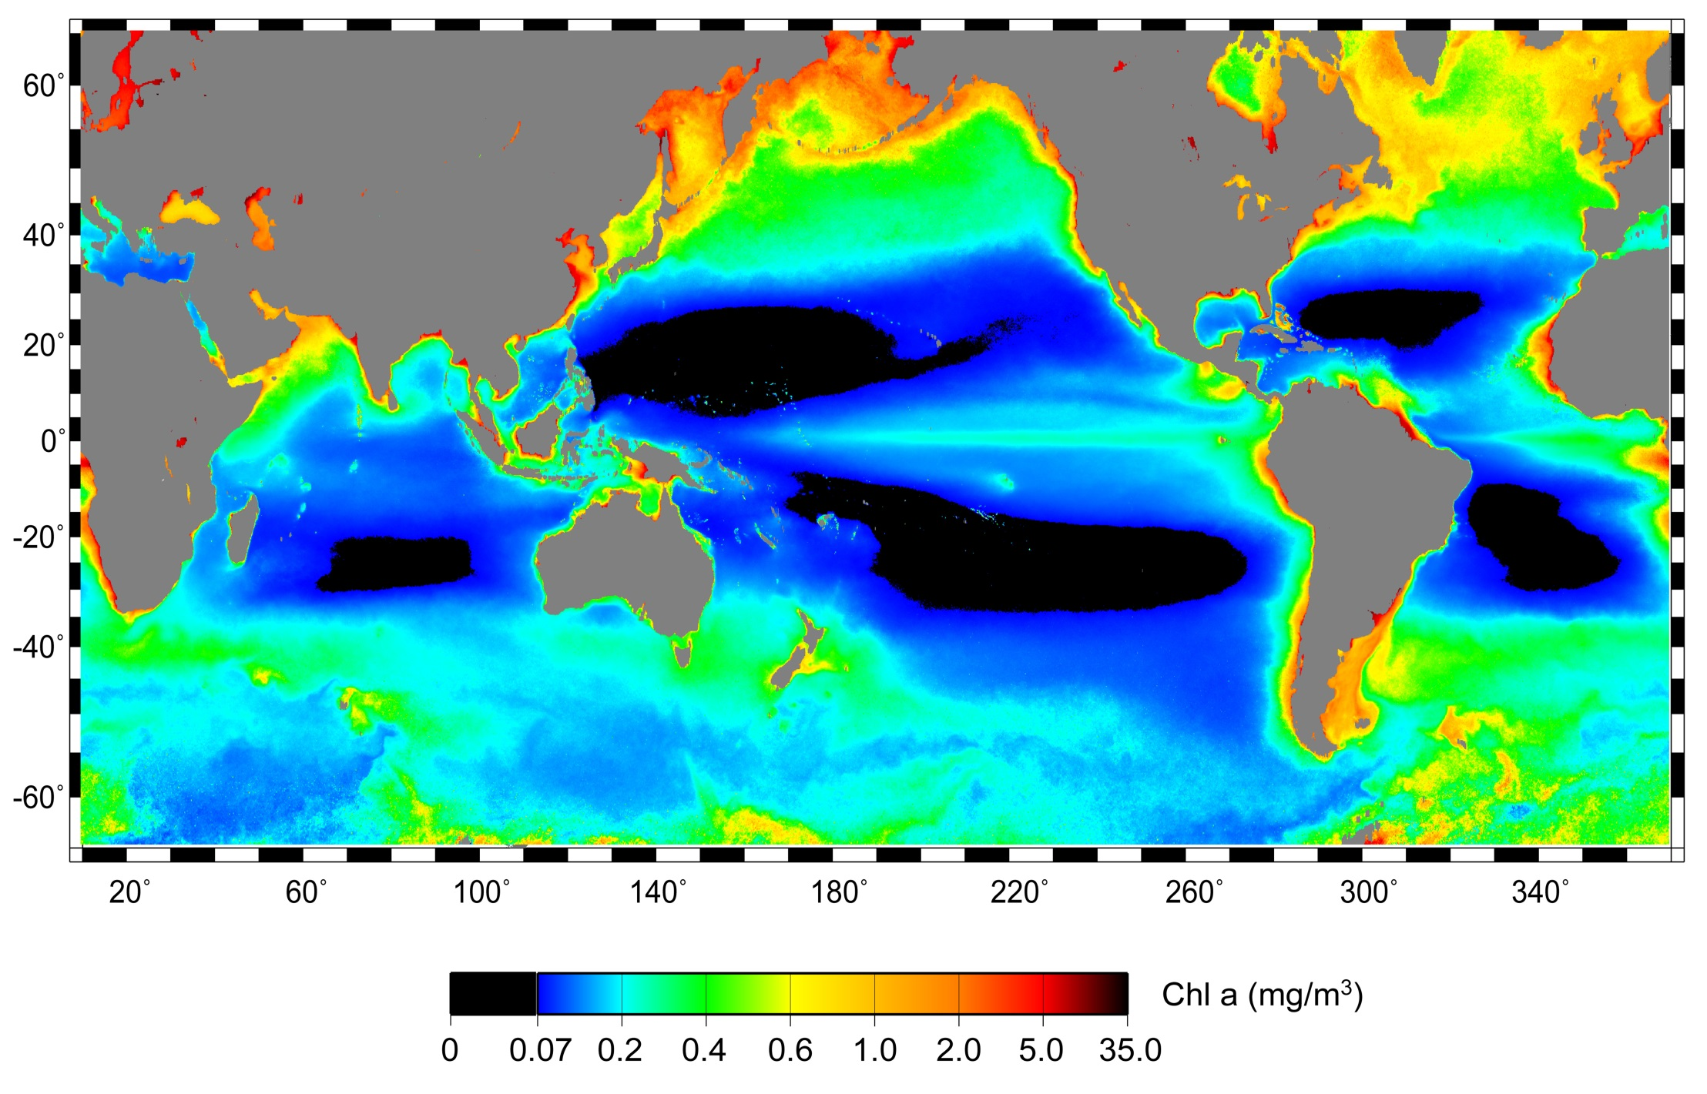
Can we turn the black areas orange?
Area of low surface chlorophyll in world ocean 2009 50 million square kilometres and growing

Slide 16
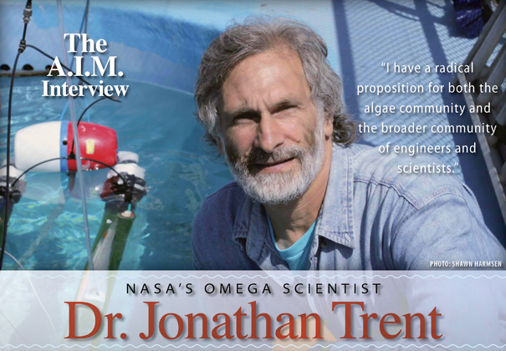
http://www.algaeindustrymagazine.com/nasas-omega-scientist-dr-jonathan-trent/

Slide 17

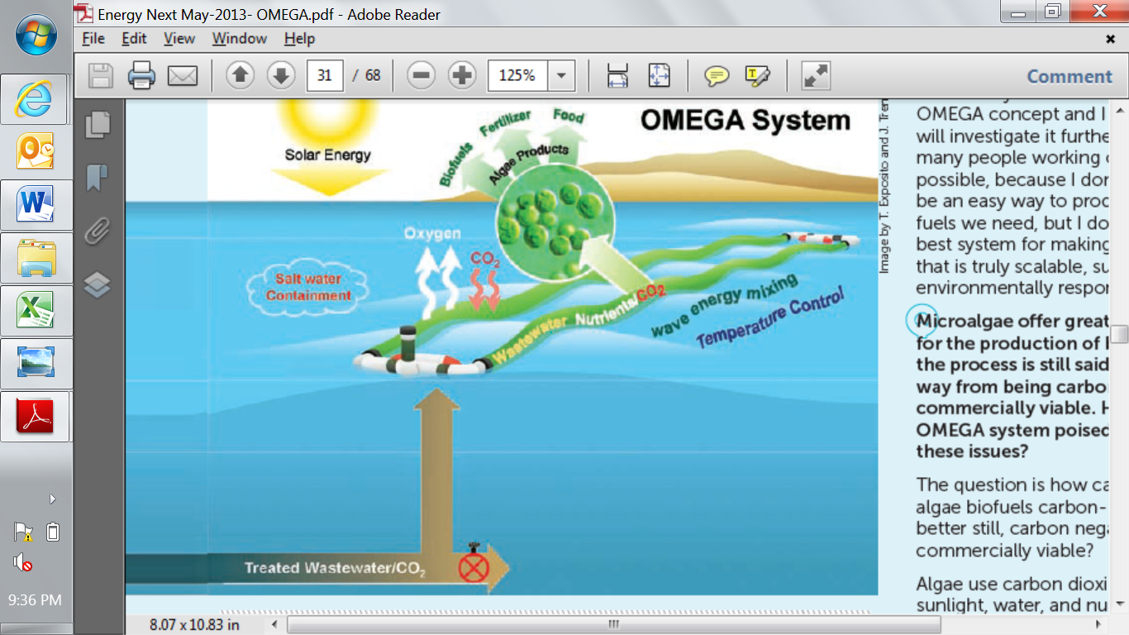
NASA Research Project
Offshore
Membrane
Enclosure for
Growing
Algae
A scalable solution?

Slide 18
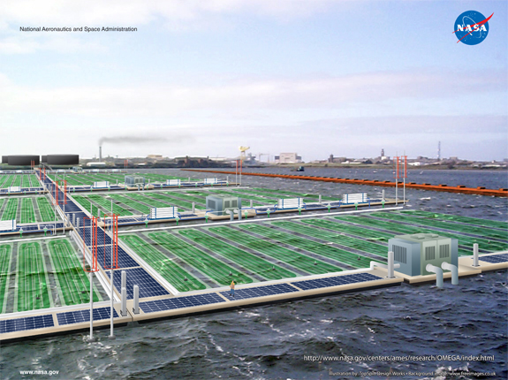

Slide 19
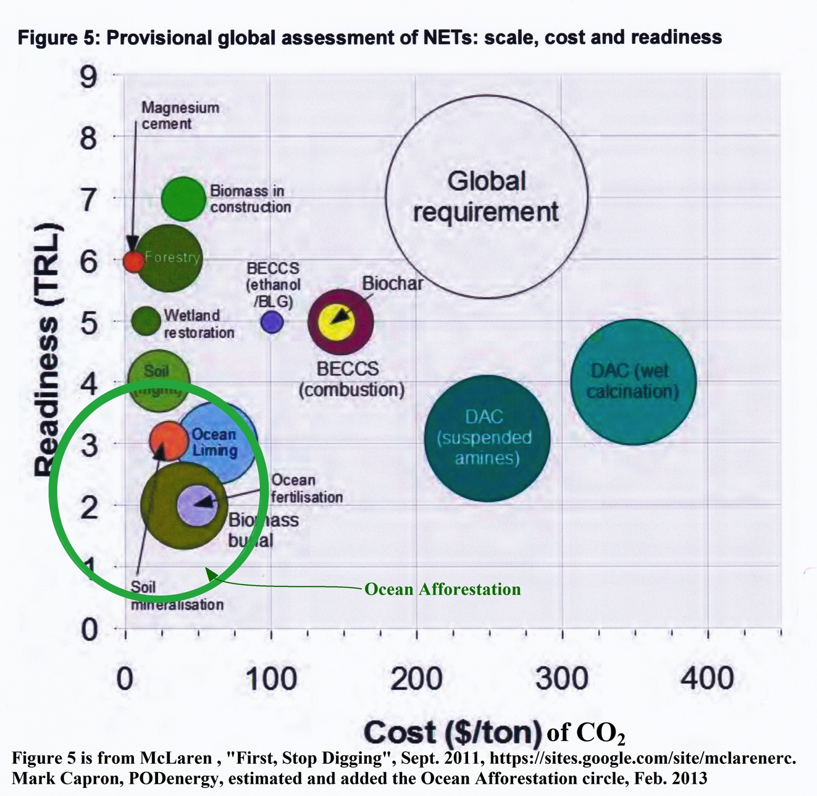
RESTORING OCEAN HEALTH WITH SEAWEED FORESTS
How to economically, sustainably, responsibly remove several trillion tons CO₂?
Ocean Seaweed Forests
OceanForesters.org
Notes:
Mark – (5 seconds of silence) The issue as McLaren has shown that to reverse climate change requires removing several trillion tons of carbon dioxide from the earth’s atmosphere and oceans. Only Ocean Seaweed Forests have the following characteristics:
Can scale up to meet the legacy CO₂ removal requirement
Prevent more CO₂ by replacing all fossil fuels
Feed the world
Restore ocean health (eliminate acidification, hypoxia, denitrification, etc.)
Make a profit, in a natural ecological sustainable restorative method.
Save this slide for answering a question?

Slide 20

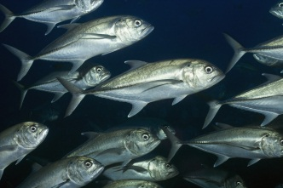
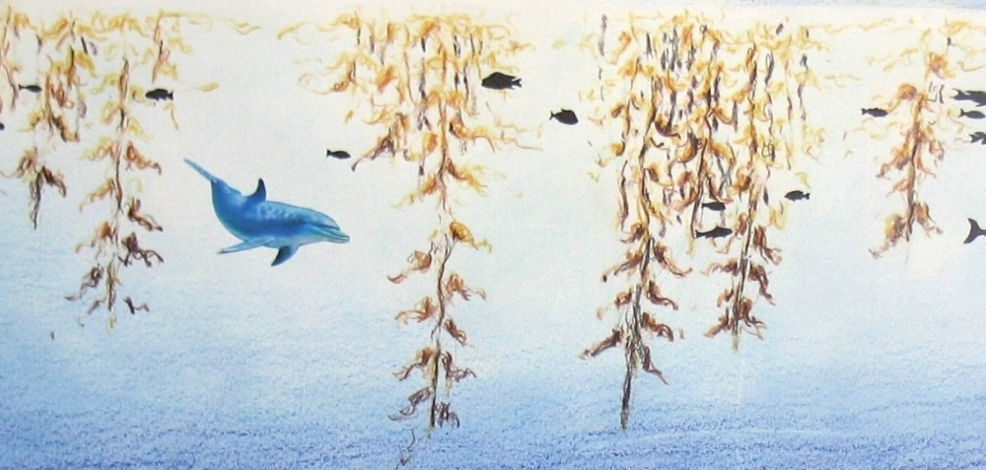
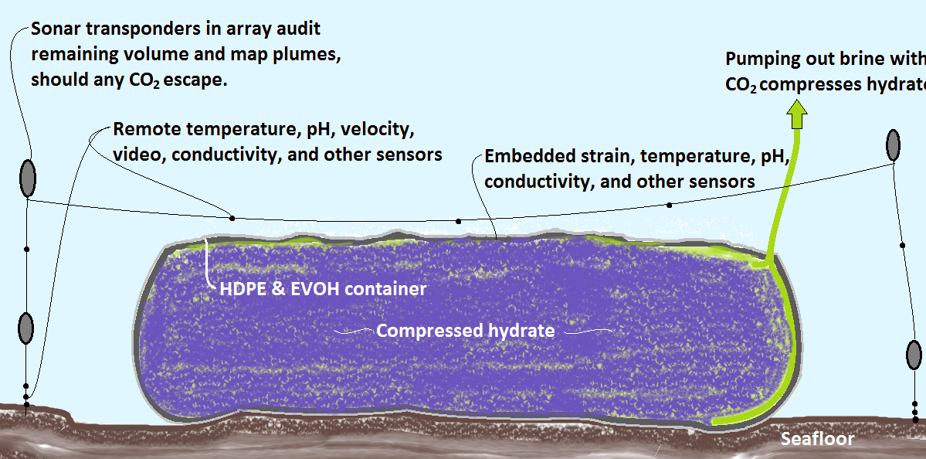
Replace all fossil fuels
Energy=600 quads/yr
2 billion tons/yr of food
+ capture 17 billion tons/yr BECCS CO₂ or reformatting CH₄ to H₂
OceanForesters.org
Existing
nutrients
Anaerobic digester
Expanding
macroalgal forest
Harvested macroalgae
8 billion tons/yr of recycled nutrients
19 billion tons/yr captured bio-CO₂
Seafloor
Notes:
Mark – We might take advantage of advances in reformatting bio-methane into hydrogen or carbon capture and storage from power plant exhaust to remove another 17 billion tons per year of carbon dioxide from our air and water.

Slide 21
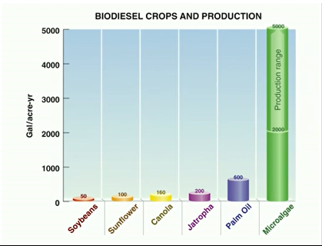
Algae could have ten times the oil production yield of the fastest growing land based crops
Algae can store much more carbon than forests, due to fast growth rate, non-displacement of food crops, availability of suitable ocean sites
Algae factories on 2% of the world ocean could be enough to reduce CO2 level from current 400 ppm to stable Holocene level of 280 ppm

Slide 22
Drawing C
Ocean-based Algae Production System
Schematic Top View of photo-bioreactor component
D
H
B
A
C
G
F
E
A: Polymer bag containing CO2, fresh water or ocean water with high nutrient level
B: Continuous flow algae photo-bioreactor chamber with arrows showing direction of liquid flow
C: Polymer bag containing fresh water for buoyancy, pumping and stability
D: Polymer bag containing algated water output from chamber (B)
E: Submarine chamber pumping water from source (A) into chamber (B). (Note, chamber E can be replaced by a tidal pump as described in separate drawing).
F: Submarine chamber pumping air or CO2 into chamber below chamber B as shown at side and front views
G: Rigid submarine platform at base of chambers E and F providing pumping resistance.
H: Return pipe transferring algated water to mix with nutrient-rich water from bag (A).
© Robert Tulip, July 2009

Slide 23
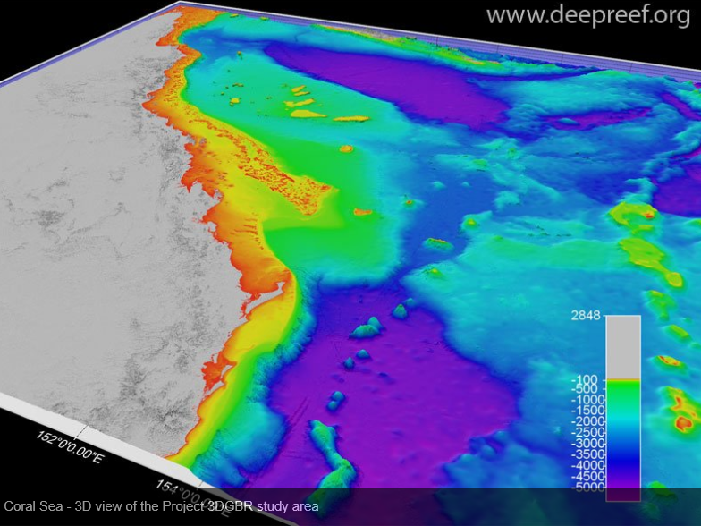
How to Protect the Reef from
Heat?
Acid?
Nutrient?
The Great Barrier Reef is at risk of collapse due to climate change
http://www.youtube.com/watch?feature=player_embedded&v=BOvrNXGJhTA

Slide 24
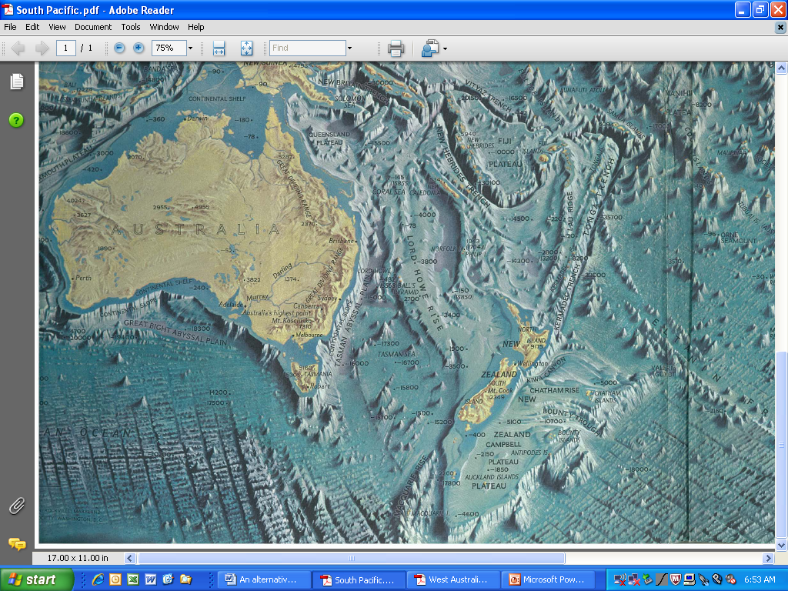
Large Scale Ocean Based Algae Production System
Grow algae in bags on continental shelf
Store algae in deep ocean
Use algae for fuel, food, fertilizer, fabric
A Silver Bullet for Climate Change?

